Slide 1
ECE 808 — CIS Applications II Smart Water Systems Exercise
Dr Demetrios Eliades
Research Assistant Professor
KIOS Research and Innovation Center of Excellence
University of Cyprus

Slide 2
Scenario
L-TOWN has decided to modernize its water distribution system. For this purpose, it has decided to invest in “Smart Water Network” technologies.
Moreover, L-TOWN is expanding with new development, which can affect the way the system operates.
The L-TOWN utility will install sensors and analytics software, for the continuous monitoring of the system.
You have been hired by the utility as a “Smart Water Consultant”, to assist in this transition.

Slide 3
Deliverable
Create a MATLAB MLX file to document all your results.
Use headings, text describing your approach, equations and comments in your code.
Submit your MLX file via email to eldemet@ucy.ac.cy by May 23, 2023.
You are free to use the code provided in the course.
[Optional] Create GitHub account, and install GitHub desktop application. Clone the course repository on your computer. Synchronize periodically to get the latest files. Create a working folder.

Slide 4
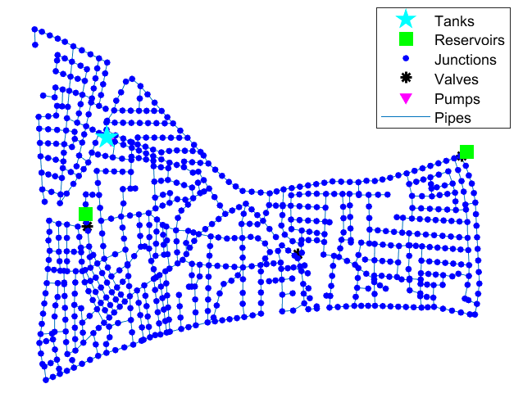
L-TOWN Network
G = epanet(‘L-Town.inp’)
G.plot
rng(XXX)
Simulation time: 7 days
Step: 5 minutes

Slide 5
Exercise 1: Exploring
Load and plot the network. Use rng(XXX) for reproducibility. In place of XXX, use the 3 last digits of your Identity Card.
Set the disinfectant as “chlorine” at the two main sources, with a concentration setpoint 0.8 mg/L.
Run a simulation using the nominal dynamics
Plot the pressure at 3 random nodes
Plot the sum of the inflow from the two water sources (reservoirs), remove the tank inflow
Plot the network using a heatmap of the chlorine concentrations at three different time instances

Slide 6
Exercise 2: Bounds
The utility has asked you to compute bounds corresponding to the pressures, flows, to design event detection algorithms.
Assume that the base demands in the EPANET file were computed with ±20% uncertainty.
Execute a Monte Carlo experiment with 100 random experiments using random values for each individual node, within the pre-specified bound.
Plot the bounds of 3 random pressure sensors, the bounds of each water source inflow and the total water inflow

Slide 7
Exercise 3: Leakage detection
Based on the bounds from the previous exercise, design an anomaly detection algorithm which detects if some hydraulic parameter (pressure at nodes or inflows) goes outside those bounds.
Simulate at least 3 different leakage events at nodes ‘n145’, ‘n342’, ‘n286’ starting at 08:00 on Day 3, with a sufficiently large leakage coefficient, and show in plots when/how the event can be first detected. (Be careful not to calculate negative pressures!)
Implement a minimum night flow algorithm with the total water inflow. Demonstrate whether your method is also able to detect the leakage events you have created.

Slide 8
Exercise 4: Contamination event
Using a sufficiently large number of randomized simulations, identify the best locations to install 5 water quality (chlorine) sensors in the network.
The utility suspects that a factory connected at node “n130” may be polluting the drinking water with dangerous substances. Create a map to show which downstream nodes could be affected.
If the system is chlorinated at both reservoirs at 0.8mg/L, and due to an accident, “n130” injects at times 12:00-14:00 Arsenic to the system (10mg/L), plot and compare how this will affect chlorine measurements at the sensor locations you selected.
Design and demonstrate a contamination detection algorithm using the bounds computed.

Slide 9
Good luck!

